Slide 1
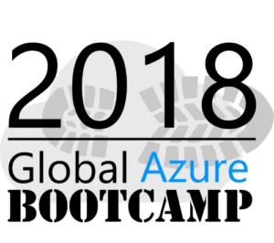
Spark as a service with Azure Databricks
21 April 2018
Lace Lofranco
Senior Software Development Engineer
Microsoft

Slide 2
Session objective
At the end of the this session, you should:
Know the key capabilities of the Azure Databricks platform and its integration with Azure services
Have a basic understanding of building advance analytics workloads with Spark on Azure Databricks

Slide 3



Hello, I’m Lace
Senior Software Development Engineer in the Commercial Software Engineering Team in Microsoft
Focus on Big Data analytics, data engineering, and machine learning
Organizer of Melbourne Azure Nights Meetup

Slide 4
Agenda
Spark Fundamentals
Unified Computing Engine
Azure Databricks
Managed Apache Spark, Integrations with Azure Services
Demo
Recommendation
System

Slide 5
Spark Fundamentals

Slide 6










Notes:
Objective: Show heterogenous set of tools in big data world
Slice of the big data ecosystem
For

Slide 7

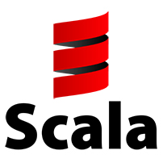
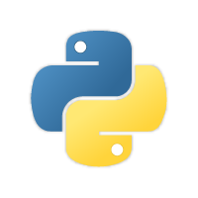




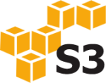

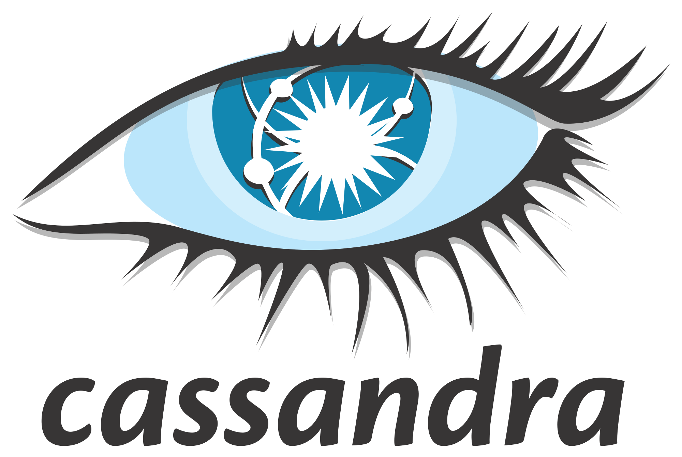
Apache Spark
a unified computing engine and a set of libraries for parallel data processing on computer clusters
Spark SQL
Structured Streaming
Mllib
(machine learning)
GraphX
(graph)
Apache Spark Core APIs
RDDs, DataFrame, Datasets
Spark: The Definitive Guide, Matei Zaharia, Bill Chambers
Notes:
Talking points:
Unified.
Computing engine. Not a storage solution (interfaces w/ existing storage)
Libraries (Mllib, GraphX, Spark SQL, Structured Streaming, open source packages)

Slide 8
Why Spark is fast
Step
Step
Step
HDFS
HDFS
HDFS
HDFS
Step
Step
Step
HDFS
RAM
RAM
RAM

Slide 9
Why Spark is fast
Step
Step
Step
HDFS
HDFS
HDFS
HDFS
Cache
Cache
Step
Step
Step
HDFS
RAM
RAM
RAM
Notes:
Developers can also choose to cache
For Jobs that reuse over again a particular Dataset

Slide 10
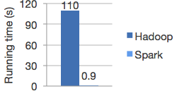
Why Spark is fast
Step
Step
Step
HDFS
HDFS
HDFS
HDFS
Cache
Cache
Step
Step
Step
Logistic regression in Hadoop vs Spark
HDFS
RAM
RAM
RAM
Source: http://spark.apache.org/

Slide 11
Apache Spark: APIs
RDDs
Core building block of data processing pipelines
DataFrames
High level APIs that take advantage of query optimizer
Datasets
Data Frames with user objects and custom code
Structured Streaming
Advanced Analytics
Libraries & Ecosystem
Structure APIs
Datasets
DataFrame
SQL
Low Level APIs
RDDs
Distributed Variables
Notes:
Different layers of API (low and high)
High over

Slide 12
Transformations and Actions
RDD
RDD
Transformations
RDD
Actions
Value
RDD
RDD
Notes:
Talking Points:
Two types of operations: Transformation and Actions
RDDs are immutable.
Apply transformation to produce a new RDD
Good property for easily distributable (functional style)
Spark is lazy
Transformations don’t trigger job, till an action

Slide 13
Transformations and Actions
Transformations | Actions
select | show
distinct | count
groupBy | collect
sum | save
orderBy | first
filter
limit
summarize
… and much more
Notes:
Talking Points:
Two types of operations: Transformation and Actions
RDDs are immutable.
Apply transformation to produce a new RDD
Good property for easily distributable (functional style)
Spark is lazy
Transformations don’t trigger job, till an action

Slide 14
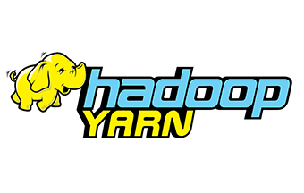

Inside a Spark Application
Driver
Executor
Executor
Executor
Spark Session
Distributed Data Structure
Partition
Partition
Partition
Partition
Partition
Partition
User code
Cluster Manager
Notes:
Objective: Describe a running spark application
Talking points:
SparkSession
Driver – heart of Spark app
Responding to user’s program or input
Maintaning info about spark app
Analyze, distribute, schedule work across executors
Executors
Doing actual work assigned by driver
Reporting back to driver
Cluster manager
Spark can use three difference cluster managers (including built in Spark cluster manager)
Cluster Managers manage actual resources
CAREFUL with collects

Slide 15
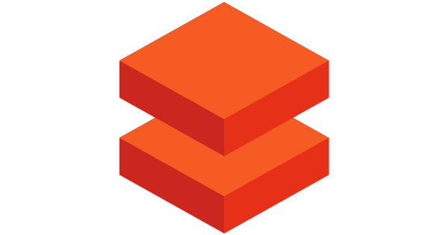
Azure Databricks Spark as a managed service on Azure

Slide 16

Azure Databricks
Managed Apache Spark platform optimized for Azure
First party service
Not an Azure Marketplace or 3rd party hosted service
Azure Integration
Azure Active Directory
Azure data connectors
Azure Billing
Power BI
Microsoft Azure
Notes:
Fun fact: Employees of Databricks have written over 75% of the code in Apache Spark

Slide 17
Demo
Hello Azure Databricks!
Notes:
OBJECTIVE: Show how easy it is to get started
- Create Databricks workspace
- Create a spark cluster
Create a notebook
Import notebook: https://databricks.com/resources/type/example-notebooks

Slide 18
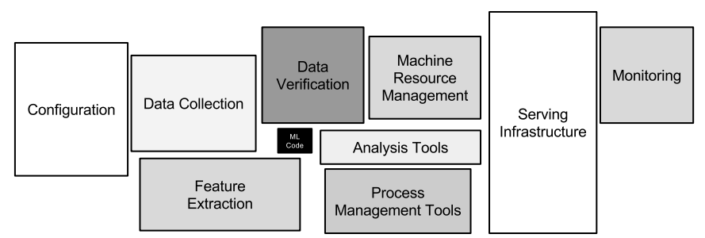
Hidden Technical Debt in ML Systems
https://papers.nips.cc/paper/5656-hidden-technical-debt-in-machine-learning-systems.pdf
Notes:
Only a small fraction of real-world ML systems is composed of the ML code, as shown by the small black box in the middle. The required surrounding infrastructure is vast and complex.

Slide 19



Azure Databricks
Azure Databricks
Collaborative Workspace
IoT / streaming data
Machine learning models
DATA ENGINEER
DATA SCIENTIST
BUSINESS ANALYST
Deploy Production Jobs & Workflows
Cloud storage
BI tools
MULTI-STAGE PIPELINES
JOB SCHEDULER
NOTIFICATION & LOGS
Data warehouses
Optimized Databricks Runtime Engine
Data exports
Hadoop storage
DATABRICKS I/O
APACHE SPARK
SERVERLESS
Rest APIs
Data warehouses
Enhance Productivity
Build on secure & trusted cloud
Scale without limits
Notes:
OBJECTIVE: Databricks makes the infrastructure (from earlier slide) around ML easier
Unified computing platform
Not only does it provide an optimized and manage Spark runtime engine
Also:
Collaborative workspace
Tools to productionize

Slide 20
Azure Integration
SECURE
Azure Active Directory
INGEST
ORCHESTRATION
VISUALIZE
Kafka on HDInsight
AZURE DATABRICKS
Power BI
STORAGE
SQL DW
Azure Data Lake
Notes:
Also tight azure integration

Slide 21
Databricks Core Concepts
Workspaces
Clusters
Notebooks
Jobs
Libraries
Tables
Notes:
Workspaces
Workspaces allow you to organize all the work that you are doing on Databricks. Like a folder structure in your computer, it allows you to save notebooks and libraries and share them with other users. Workspaces are not connected to data and should not be used to store data. They're simply for you to store the notebooks and libraries that you use to operate on and manipulate your data with.
Notebooks
Notebooks are a set of any number of cells that allow you to execute commands. Cells hold code in any of the following languages: Scala, Python, R, SQL, or Markdown. Notebooks have a default language, but each cell can have a language override to another language. This is done by including %[language name] at the top of the cell. For instance %python. We'll see this feature shortly.
Notebooks need to be connected to a cluster in order to be able to execute commands however they are not permanently tied to a cluster. This allows notebooks to be shared via the web or downloaded onto your local machine.
Here is a demonstration video of Notebooks.
Dashboards
Dashboards can be created from notebooks as a way of displaying the output of cells without the code that generates them.
Notebooks can also be scheduled as jobs in one click either to run a data pipeline, update a machine learning model, or update a dashboard.
Libraries
Libraries are packages or modules that provide additional functionality that you need to solve your business problems. These may be custom written Scala or Java jars; Python eggs or custom written packages. You can write and upload these manually or you may install them directly via package management utilities like pypi or maven.
Tables
Tables are structured data that you and your team will use for analysis. Tables can exist in several places. Tables can be stored in cloud storage, they can be stored on the cluster that you're currently using, or they can be cached in memory. For more about tables see the documentation.
Clusters
Clusters are groups of computers that you treat as a single computer. In Databricks, this means that you can effectively treat 20 computers as you might treat one computer. Clusters allow you to execute code from notebooks or libraries on set of data. That data may be raw data located on cloud storage or structured data that you uploaded as a table to the cluster you are working on.
It is important to note that clusters have access controls to control who has access to each cluster.
Here is a demonstration video of Clusters.
Jobs
Jobs are the tool by which you can schedule execution to occur either on an already existing cluster or a cluster of its own. These can be notebooks as well as jars or Python scripts. They can be created either manually or via the REST API.
Here is a demonstration video of Jobs.
Apps
Apps are third party integrations with the Databricks platform. These include applications like Tableau.

Slide 22
Databricks Core Concepts
Workspaces
Clusters
Notebooks
Jobs
Libraries
Tables
Secrets (Preview)
Notes:
Workspaces
Workspaces allow you to organize all the work that you are doing on Databricks. Like a folder structure in your computer, it allows you to save notebooks and libraries and share them with other users. Workspaces are not connected to data and should not be used to store data. They're simply for you to store the notebooks and libraries that you use to operate on and manipulate your data with.
Notebooks
Notebooks are a set of any number of cells that allow you to execute commands. Cells hold code in any of the following languages: Scala, Python, R, SQL, or Markdown. Notebooks have a default language, but each cell can have a language override to another language. This is done by including %[language name] at the top of the cell. For instance %python. We'll see this feature shortly.
Notebooks need to be connected to a cluster in order to be able to execute commands however they are not permanently tied to a cluster. This allows notebooks to be shared via the web or downloaded onto your local machine.
Here is a demonstration video of Notebooks.
Dashboards
Dashboards can be created from notebooks as a way of displaying the output of cells without the code that generates them.
Notebooks can also be scheduled as jobs in one click either to run a data pipeline, update a machine learning model, or update a dashboard.
Libraries
Libraries are packages or modules that provide additional functionality that you need to solve your business problems. These may be custom written Scala or Java jars; Python eggs or custom written packages. You can write and upload these manually or you may install them directly via package management utilities like pypi or maven.
Tables
Tables are structured data that you and your team will use for analysis. Tables can exist in several places. Tables can be stored in cloud storage, they can be stored on the cluster that you're currently using, or they can be cached in memory. For more about tables see the documentation.
Clusters
Clusters are groups of computers that you treat as a single computer. In Databricks, this means that you can effectively treat 20 computers as you might treat one computer. Clusters allow you to execute code from notebooks or libraries on set of data. That data may be raw data located on cloud storage or structured data that you uploaded as a table to the cluster you are working on.
It is important to note that clusters have access controls to control who has access to each cluster.
Here is a demonstration video of Clusters.
Jobs
Jobs are the tool by which you can schedule execution to occur either on an already existing cluster or a cluster of its own. These can be notebooks as well as jars or Python scripts. They can be created either manually or via the REST API.
Here is a demonstration video of Jobs.
Apps
Apps are third party integrations with the Databricks platform. These include applications like Tableau.

Slide 23
Databricks File System (DBFS)
Distributed file system that is a layer over Azure Blob Storage
Data is persisted even after cluster termination
Data can be cached locally on the SSD of the worker nodes
Available in Python and Scala and accessible via DBFS CLI
CLI
dbutils
DBFS
db.fs.mount()
Notes:
If Spark is computing engine, where does Databricks store the data?

Slide 24
Demo
Mount Blob Storage in DBFS
Notes:
Mount Blob Storage (WITHOUT SECRET API)

Slide 25
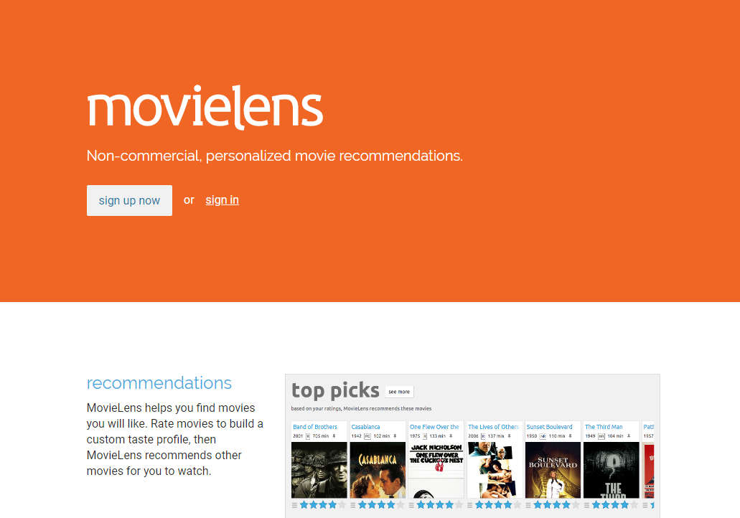
Movie Recommendation System
MovieLens Dataset
26M ratings and 750K tag applications applied to 45K movies by 270K users
https://movielens.org/
F. Maxwell Harper and Joseph A. Konstan. 2015. The MovieLens Datasets: History and Context. ACM Transactions on Interactive Intelligent Systems (TiiS) 5, 4, Article 19 (December 2015), 19 pages. DOI=http://dx.doi.org/10.1145/2827872

Slide 26
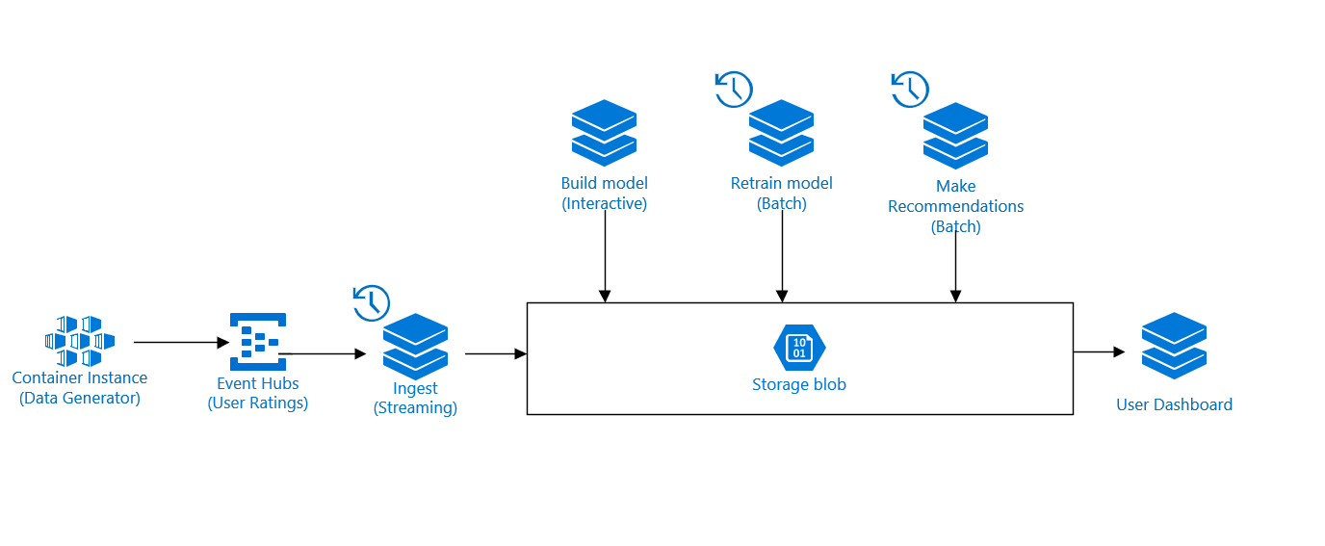
Demo Architecture

Slide 27
Spark SQL
Spark's interface for working with structured and semi-structured data
Built on the DataFrame & Datasets API
Hive Integration
Provides JDBC/ODBC access
Spark SQL
Structured Streaming
Mllib
(machine learning)
GraphX
(graph)
Apache Spark Core APIs
RDDs, DataFrame, Datasets

Slide 28
Demo
Create and query Tables with Spark SQL
Notes:
Create a spark SQL notebook
Spark SQL, setup tables

Slide 29
Spark Structured Streaming
Scalable and fault-tolerant stream processing engine
Successor of Spark Streaming (DStreams API)
Same code for Batch and Streaming
Spark SQL
Structured Streaming
Mllib
(machine learning)
GraphX
(graph)
Apache Spark Core APIs
RDDs, DataFrame, Datasets

Slide 30
Demo Architecture

Slide 31
Demo
Ingest ratings data from Event Hubs with Spark Structured Streaming
Notes:
- Libraries (add event hub library and attach to cluster)
- Ingest data with Spark Streaming

Slide 32
Spark MLlib
Scalable Machine Learning library on Spark
Common ML algorithms
classification, regression, clustering, & collaborative filtering
Featurization
Feature extraction, Transformation, dimensionality reduction
ML Pipelines
Combine Transformers and Estimators
Spark SQL
Structured Streaming
Mllib
(machine learning)
GraphX
(graph)
Apache Spark Core APIs
RDDs, DataFrame, Datasets

Slide 33
Demo Architecture

Slide 34
Demo
Build collaborative filtering recommendation model with Spark ML
Notes:
Ingest data with Spark Streaming

Slide 35
Productionizing Machine Learning Workloads
ML persistence
Sparks support saving multi- stage models built by Data Scientist in Python/R and loading in Scala/Java
Schedule pipelines with Jobs
Notification and alerting
Collaborative Workspace
DATA ENGINEER
DATA SCIENTIST
BUSINESS ANALYST
Deploy Production Jobs & Workflows
MULTI-STAGE PIPELINES
JOB SCHEDULER
NOTIFICATION & LOGS

Slide 36
Demo Architecture

Slide 37
Demo
Productionize workflow with Spark Jobs
Notes:
As a data engineer, no need to rewrite model… just load it
Creating an scheduling Job

Slide 38
Visualize with Dashboards
Convert Notebooks into Dashboards
Parameterize Notebooks using Widgets
Collaborative Workspace
DATA ENGINEER
DATA SCIENTIST
BUSINESS ANALYST
Deploy Production Jobs & Workflows
MULTI-STAGE PIPELINES
JOB SCHEDULER
NOTIFICATION & LOGS

Slide 39
Demo Architecture

Slide 40
Demo
User Recommendation Dashboard
Notes:
As a data engineer, no need to rewrite model… just load it
Creating an scheduling Job

Slide 41
Try the demo!
https://github.com/devlace/azure-databricks-recommendation-system
To deploy…
make deploy
To download requirements…
make requirements

Slide 42
More resources
Official Apache Spark website
Azure Databricks Documentation
[Book] Spark: The Definitive Guide

Slide 43
Thank you!
Lace Lofranco
Senior Software Development Engineer
Commercial Software Engineering
Microsoft
lace.lofranco@microsoft.com

Slide 44





POSITIONING THE DIFFERENT BIG DATA SOLUTIONS
Different Big Data Solutions
CONTROL
EASE OF USE
Azure Data Lake
Analytics
Data Engineering in a
Job-as-a-service model
Azure Databricks
Frictionless & Optimized Spark clusters
Azure HDInsight
Workload optimized, managed clusters
Reduced Administration
Azure Marketplace
HDP | CDH | MapR
BIG DATA ANALYTICS
Any Hadoop technology, any distribution
IaaS Clusters
Managed Clusters
Big Data as-a-service
Azure Data Lake Store
BIG DATA STORAGE
Azure Storage

